Slide 1
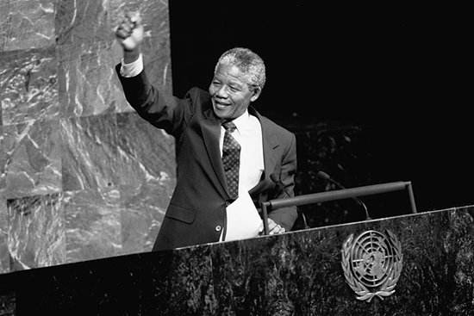
Unit 5
Nelson Mandela
-- a modern hero

Slide 2


Slide 3

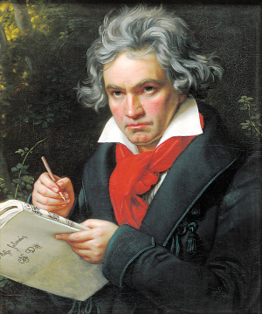
1. A great person is someone who devotes his/her life to helping others.
devote vt. (与介词to连用)
献身; 致力于
He ________ all his life ____ music.
devoted to

Slide 4
【语境应用】
1) I’m ________ all my time and energy
____________ a mom right now.
目前我把所有时间和经历都放在当妈
妈这件事上。
devoting
to being
2) Kiko ____________ her music.
基科热爱她的音乐。
is devoted to

Slide 5
2. Sadly I did not have one because I was not born there, and I worried about whether I would become out of work.
out of work 失业

Slide 6
out of + n. 短语
控制不了的
过时的
上气不接下气的
失去联系
失去平衡
out of control
out of date
out of breath
out of touch
out of balance

Slide 7
3. “The last thirty years have seen the greatest number of laws stopping our rights and progress, …”
see vt. 目睹, 经历
see不用于进行时, 主语通常是表示时间、地点的名词/代词。
e.g. The old house ___ ____their happy life.
翻译：
这一所老房子见证了他们的幸福生活。

Slide 8
4. Black people could not vote or choose their leaders.
vote作动词时, 意为“投票, 选举”
e.g. Whether you vote for or against
the plan doesn’t seem to matter
very much.
More than half of the people
present voted in favor of Jack.
As we can’t agree on this matter,
let’s vote on it.

Slide 9
常用于以下结构：
vote against 投票反对
vote for 投票赞成
vote on 投票表决

Slide 10
【语境应用】
1) 下届选举我可能选她。
I may ____ ____ her at the next election.
vote for
2) 投票反对该提议的人占少数。
voted against
A small minority ______ ________ the proposal.
3) 给妇女选举权！
Give women the _____!
vote

Slide 11
5. But I was happy to help because I knew it would help us achieve our dream of making black and white people equal.
equal adj. 相等的, 平等的, 能胜任的
be equal to sth. 等于……, 能胜任 ……
be equal in sth. 在某方面相等
v. 等于, 和……相等, 比得上
n. 相等的人, 事物, 对手

Slide 12
【语境应用】
equal to
1) I’m not _______ _____ the position.
我不能胜任这个职务。
equal in
2) Not all men are ______ ____ ability.
人的能力并不都是一样的。
equals
3) Four plus four _______ eight.
四加四等于八。
equals in
4) No one ______ him ______ strength.
论力气, 无人能和他相比。

Slide 13
6. Elias went to see Nelson Mandela when he was in trouble.
in trouble
在危险、受罚、痛苦、忧虑等的处境中
e.g.
She’ll be in big trouble if she crashes Sam’s car.
out of trouble 摆脱麻烦

Slide 14
【拓展】
(使某人)陷入困境
(使某人)摆脱困境
制造麻烦
自找麻烦
做某事有困难
不辞劳苦地做某事
get (sb.) into trouble
get (sb.) out of trouble
cause/make trouble
ask for/look for trouble
have trouble in doing sth.
take the trouble to do sth.

Slide 15
【语境应用】
1) 那个男孩儿总是惹麻烦, 现在他自己有麻烦了。
The naughty boy is always _________ ________, but now he is ___________.
2) 我正在努力使他摆脱困境。
I am trying hard to _______________ ________.
making
trouble
in trouble
get him out of
trouble

Slide 16
7. Why did Nelson Mandela turn to violence to make black and white people equal?
turn to
专心于; 翻到(书的某页);
求助于; (使……)变成; 查阅(书等)

Slide 17
【拓展】
turn on 打开 turn off 关闭
turn up 调高(声音等), 出现
turn down 调低(声音等), 拒绝
【语境应用】用含turn的短语的正确形式填空。
1) To save energy, please ________ the lights when you leave.
2) If Tom doesn’t ________ soon, we shall have to go without him.
turn off
turn up

Slide 18
3) I had no one to ________ for advice.
4) Bob __________ his computer and
checked his mail.
5) The old man was poor but proud, and
___________ every offer of help.
6) You should ________ your thoughts ________ study.
turn to
turned on
turned down
turn
to

Slide 19

8. We first broke the law in a way which was peaceful; when this was not allowed … only then did we decide to answer violence with violence.
首先我们用和平的方式来破坏法律, 而当这种方式也得不到允许时, ……只有到这个时候, 我们才决定用暴力反抗暴力。

Slide 20
定语从句
此句中含有which引导的_________, 修饰先行词______, which在从句中做 ______; 还含有when引导的时间状语从句。
Only then引导一个___________, 当only修饰状语 放于句首时, 句子用_________结构, 即助动词/be动词/情态动词提前。
a way
主语
部分倒装句
部分倒装

Slide 21
【语境应用】
which/that
1) I don’t like the way __________ were taught by our teacher.
in which / that / \
2) I don’t like the way ________________ you talk to me.
3) 只有努力工作, 你才能成功。
_____ _____ working hard ______ you
succeed.
Only by
can

Slide 22

Complete the passage with words and the phrase from the box below. You may change the form if necessary.
equal official worry about mankind lawyer attack republic quality violence legal hopeful vote active
My name is Robert Sobukwe. Like Nelson Mandela I was a _______ who believed that all _________ is created ______.
lawyer
mankind
equal

Slide 23
equal official worry about mankind lawyer attack republic quality violence legal hopeful vote active
violence
legal
I hate ________ and tried to use _____ ways so that black people could ____ for their government. As I live in South Africa, the _______ of the South African ________ did not agree with me.
vote
officials
Republic

Slide 24
equal official worry about mankind lawyer attack republic quality violence legal hopeful vote active
attacked
They ________ me for encouraging the blacks to fight against the government and put me in prison. Nobody was allowed to talk to me for five long years and I lost the ability to talk. Before I went to prison, I had been _______ that things would change.
hopeful

Slide 25
equal official worry about mankind lawyer attack republic quality violence legal hopeful vote active
quality
After I was released I found the ______ of life for black people had got worse. I was _____________ my future, and soon I fell ill. Although I was not as successful as Nelson Mandela, many people remember me as one of the first ______ black fighters for human rights in South Africa.
worried about
active

Slide 26


I. 根据下面各句句意以及所给单词的首字母或汉语提示词, 写出该单词的正确形式。
vote
1. Did you v________ for or against the plan?
2. When costs are cut product q________ suffers.
3. She’s over 80, but is still very ________ (活跃的).
quality
active

Slide 27
4. Her family ________ (建立) the company in 1890.
5. We were advised to seek ________ (法律的) advice.
6. He’s too ________ (吝啬的) to buy a present for his wife.
7. Mr. Neil was a________ by a young man and seriously injured.
8. Our education system should provide ________ (平等的) opportunities for all children.
founded
legal
mean
attacked
equal

Slide 28
II. 用括号内单词的正确形式填空。
1. It’s very ________ (peace) out here in the
woods.
2. It seems ________ (fair) to make him pay
for everything. I don’t like that.
3. I’m glad that everyone’s feeling pretty
________ (hope) about the future.
4. I was looking forward to working under
her expert ________ (guide).
5. I think I’ve been very ________ (self). I’ve
been mainly concerned with myself.
peaceful
unfair
hopeful
guidance
selfish

Slide 29
III. 根据括号内的汉语提示补全下面句子(每
空一词)。
1. He never came except when he was
________ ________ (处于麻烦中).
2. We ______ ________ ________ ________
(乐意帮忙) in any way we can.
3. Many roads, bridges and railways were
________ ________ (炸掉) in the war.
in trouble
are willing/ to help
/pleased/glad
blow up

Slide 30
4. When the company shut down, 150 people
were all _______ _______ _______ (失
业) and had to find another job.
5. She decided to ________ ________
_______ _______ _______ _______ ______
(把她的余生投入到) medical research.
6. He appears to be strong and healthy, but,
______ _______ _______ _______ ______
(事实上), he suffers from a very weak
heart.
out of work
devote the
rest of his life to
as a matter of fact

Slide 31


